Slide 1
Assessment of Direct Economic Cost of Delay at Texas-Mexico Commercial LPOE
February 02, 2023

Slide 2
Background: Motivation
The direct cost of border delays varies based on the commodities carried across each LPOE, which vary across Texas LPOEs
Just-In-Time (JIT) commodities have higher cost of delay than non-JIT
The El Paso region LPOEs carry a significant amount of JIT cargo
The DCET allows incorporating these costs into estimates
El Paso MPO is interested in leveraging the work on SB 1907 by expanding the scope of analysis to compare cost of total delay across LPOEs in the El Paso, Laredo and the Rio Grande Valley

Slide 3
Objective
Compare the impacts of border crossing delays across five Texas LPOEs by incorporating the value and volume of the commodities being transported into the cost of delay calculation.
Demonstrate the influence that cargo mix in each LPOE has on the costs of delay
Provide a more comprehensive framework to evaluate and prioritize improvements aimed at reducing the costs of delays
LPOEs include:
Bridge of the Americas (BOTA) in El Paso;
Ysleta-Zaragoza Bridge in El Paso;
World Trade Bridge in Laredo;
Laredo-Colombia Solidarity Bridge in Laredo;
Veterans-Los Tomates Bridge in Brownsville;
Santa Teresa Bridge in Santa Teresa.

Slide 4
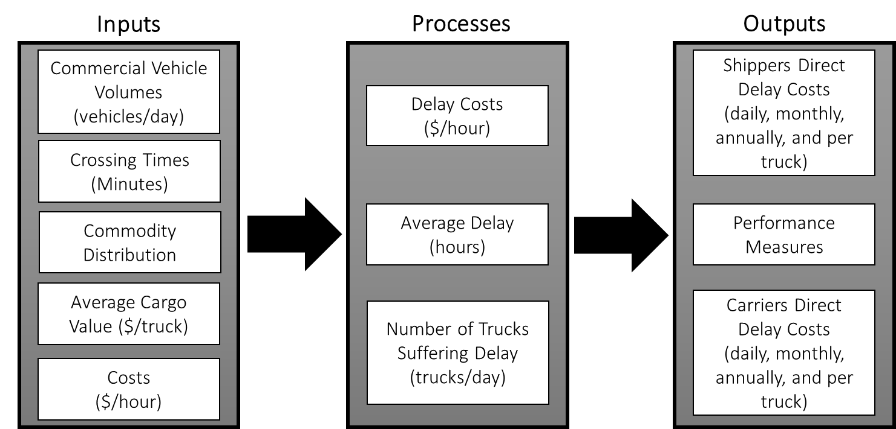
Direct Cost Estimation Tool
Notes:
Direct Cost Estimation Tool has mainly 5 inputs. In the tool average delay is defined as the excess of time required for commercial vehicles to cross the border over the selected free flow crossing time. This is the 10th percentile from all crossing times reported. Using that threshold 10th percentile, the number of trucks experiencing delay is calculated. For the outputs; direct delay costs for shippers and carriers are calculated multiplying delay costs by average delay and number of trucks experiencing delays

Slide 5
Commercial Vehicle Volumes (No. of trucks)
Notes:
This Figure shows the trends of number of trucks crossed Northbound since 2013 annually.

Slide 6
Commercial Vehicle Volumes (with loaded truck rates)
Notes:
This Figure demonstrates 2019 commercial vehicle volumes including the rates of loaded trucks reported for each month.

Slide 7
Average Crossing Times
Notes:
Average Crossing times. Data was gathered from Border Crossing Information System for each month. This study used 2019 data that summarizes the average crossing times through one year period for the Standard and FAST lanes. (older data was used to estimate the 2019 border crossing)

Slide 8
Crossing Times
LPOE | Average Standard | Average FAST | Median Standard | Median FAST
BOTA | 90 min. | 89 min. | 65 min. | 58 min.
Brownsville | 52 min. | 38 min. | 45 min. | 32 min.
Colombia | 76 min. | 74 min. | 44 min. | 31 min.
Santa Teresa | 52 min. | 34 min. | 25 min. | 23 min.
World Trade Bridge | 87 min. | 86 min. | 70 min. | 70 min.
Zaragoza | 71 min. | 69 min. | 65 min. | 65 min.
Notes:
Average Crossing times. Data was gathered from Border Crossing Information System for each month. This study used 2017 to 2019 data that summarizes the average crossing times through one year period for the Standard and FAST lanes.

Slide 9
Median Crossing Times
Notes:
Average Crossing times. Data was gathered from Border Crossing Information System for each month. This study used 2019 data that summarizes the average crossing times through one year period for the Standard and FAST lanes. (older data was used to estimate the 2019 border crossing)

Slide 10
Commodity Distribution
Export HS Code
Manufactured Goods
Other
Just in time
Non
Just in time
Agricultural Goods
Perishables
Non-Perishables
Notes:
Datamyne and BTS provide Export Codes (HS) when they report total weight and value of the cargos. This study listed the commodity codes based on their first two digits and put under into three main groups and with their subgroups in total 5 commodity groups (i) just-in-time (ii) non-just-in-time (iii) perishables, (iv) non-perishables, and (v) other.

Slide 11
Commodity Distribution (just-in-time)

Slide 12
Commodity Distribution (just-in-time)
Notes:
This figure represents the monthly loaded truck distribution of the just-in-time commodity group in 2019

Slide 13
Commodity Distribution (non-just-in-time)

Slide 14
Commodity Distribution (non-just-in-time)
Notes:
This figure represents the monthly loaded truck distribution of the non-just-in-time commodity group in 2019

Slide 15
Commodity Distribution (perishables)

Slide 16
Commodity Distribution (perishables)
Notes:
This figure represents the monthly loaded truck distribution of the perishable commodity group in 2019

Slide 17
Commodity Distribution (non-perishables)

Slide 18
Commodity Distribution (non-perishables)
Notes:
This figure represents the monthly loaded truck distribution of the non-perishable commodity group in 2019

Slide 19
Commodity Distribution (other)

Slide 20
Commodity Distribution (other)
Notes:
This figure represents the monthly loaded truck distribution of the other commodity group in 2019

Slide 21
Average Cargo Value (just-in-time)
Notes:
This figure represents the average cargo value (U.S. dollars per truck) for the just-in-time commodity group in 2019.

Slide 22
Average Cargo Value (just-in-time)
Notes:
This is a new slide added after the presentation. Eduardo wanted to see the change of JIT cargo value for El Paso after adding Santa Teresa (black line)

Slide 23
Average Cargo Value (non-just-in-time)
Notes:
This figure represents the average cargo value (U.S. dollars per truck) for the non-just-in-time commodity group in 2019

Slide 24
Average Cargo Value (non-just-in-time)
Notes:
This figure represents the average cargo value (U.S. dollars per truck) for the non-just-in-time commodity group in 2019

Slide 25
Average Cargo Value (perishables)
Notes:
This figure represents the average cargo value (U.S. dollars per truck) for the perishable commodity group in 2019

Slide 26
Average Cargo Value (perishables)
Notes:
This figure represents the average cargo value (U.S. dollars per truck) for the perishable commodity group in 2019

Slide 27
Average Cargo Value (non-perishables)
Notes:
This figure represents the average cargo value (U.S. dollars per truck) for the non-perishable commodity group in 2019

Slide 28
Average Cargo Value (non-perishables)
Notes:
This figure represents the average cargo value (U.S. dollars per truck) for the non-perishable commodity group in 2019

Slide 29
Average Cargo Value (other)
Notes:
This figure represents the average cargo value (U.S. dollars per truck) for the other commodity group in 2019

Slide 30
Average Cargo Value (other)
Notes:
This figure represents the average cargo value (U.S. dollars per truck) for the other commodity group in 2019

Slide 31
Costs (2019)
Shipper costs
Inventory Cost
Inventory Risk Cost:18 % of average cargo value
Capital Cost Interest:3.25% of average cargo value
Additional Logistics Cost
Reliability Cost for Buffer Time: $168.53/hour
Reliability Cost for Schedule Delay: $371.33/hour
Carrier costs
Fuel price
Updated monthly
Driver wages
El Paso
Laredo
Brownsville
Notes:
Driver wages: bureau of labor statistics
Fuel price: energy information administration
Inventory cost: Council of Supply Chain Management
Additional Logistics Cost: Small, K., R. Noland., X, Chu and D. Lewis. Valuation of Travel-Time Savings and Predictability in Congested Conditions for Highway User-Cost Estimation, NCHRP 431, 1999

Slide 32
DCET Process
Delay Costs ($/hour). Account for:
Inventory Costs
Logistics Costs
Carrier Costs
Operating Costs
Average Delay, Free Flow Delay
Number of Trucks Suffering Delay
Empty Trucks
Loaded Trucks
Commodity distribution

Slide 33
DCET Outputs (Standard)
Ranking
World Trade
Zaragoza
Colombia
BOTA
Brownsville
Santa Teresa
Notes:
71 percent of trucks use Standard lanes

Slide 34
DCET Outputs (FAST)
Ranking
World Trade
Zaragoza
Colombia
BOTA
Brownsville
Santa Teresa
Notes:
29 percent of trucks use FAST lanes

Slide 35
DCET Outputs (Total)
Ranking
World Trade
Zaragoza
Colombia
BOTA
Brownsville
Santa Teresa
Notes:
Total cost of delay by port (combination of FAST and Standard lanes)

Slide 36
DCET Outputs (Shipper Costs-Total)
Ranking
World Trade
Zaragoza
Colombia
BOTA
Brownsville
Santa Teresa
Notes:
Carrier cost of delay per port

Slide 37
DCET Outputs (Shipper Costs-Average Cost per Truck)
Ranking
Colombia
World Trade
BOTA
Zaragoza
Brownsville
Santa Teresa

Slide 38
DCET Outputs (Carrier Costs-Total)
Ranking
World Trade
Zaragoza
Colombia
BOTA
Brownsville
Santa Teresa
Notes:
Carrier cost of delay per port

Slide 39
DCET Outputs (Carrier Costs-Average Cost per Truck)
Ranking
World Trade
BOTA
Colombia
Zaragoza
Brownsville
Santa Teresa

Slide 40
DCET Outputs (Unit Average Delay Cost) 10 minutes of delay for 100 trucks
Notes:
This study developed a secondary approach to see the impact of commodity distribution and the average cargo values. In this approach DCET was run for every month assuming that at each port only 100 trucks experienced only 10 minutes of delay. In other words, we fixed two key inputs of the tool (crossing times and truck volumes).

Slide 41
DCET Outputs (Unit Average Delay Cost) 1 minutes of delay for 1 truck
Ranking
Santa Teresa
World Trade
Zaragoza
Colombia
BOTA
Brownsville
Notes:
This is a new slide added after the meeting. MPO wanted to see the delay per truck per minute.

Slide 42
THANK YOU
Research Team
Rafael Aldrete
r-aldrete@tti.tamu.edu
Swapnil Samant
s-samant@tti.tamu.edu
Okan Gurbuz
o-gurbuz@tti.tamu.edu
Erik Vargas
e-vargas@tti.tamu.edu

Slide 43
Commercial Vehicle Volumes

Slide 44
Just-in-time details-total weight (kg)

Slide 45
Just-in-time details-unit price ($/kg)

